Slide 1
Embeddings

Slide 2
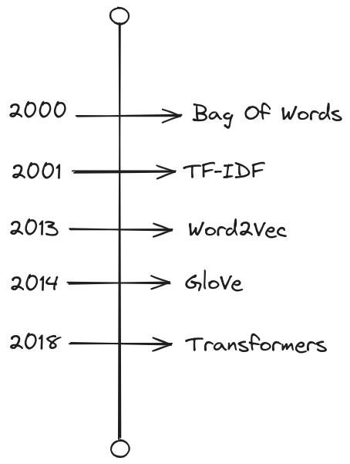

Slide 3
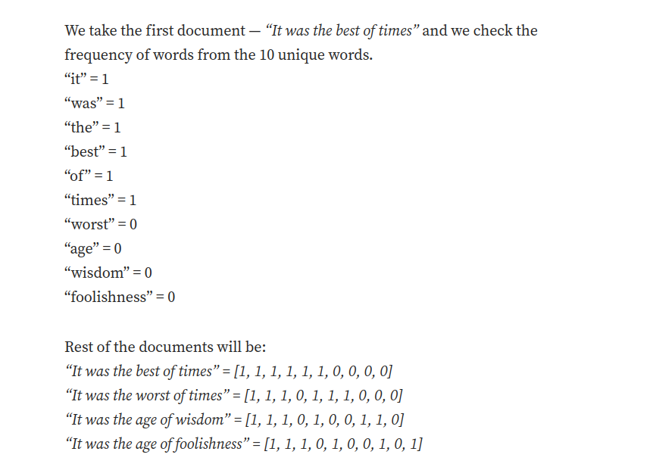
Bag of words

Slide 4
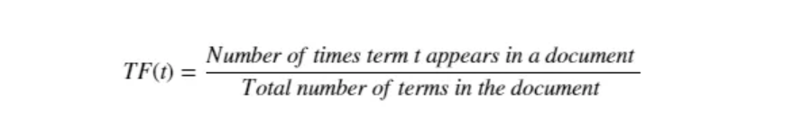
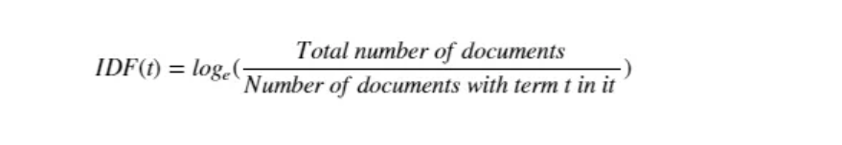
TF-IDF

Slide 5
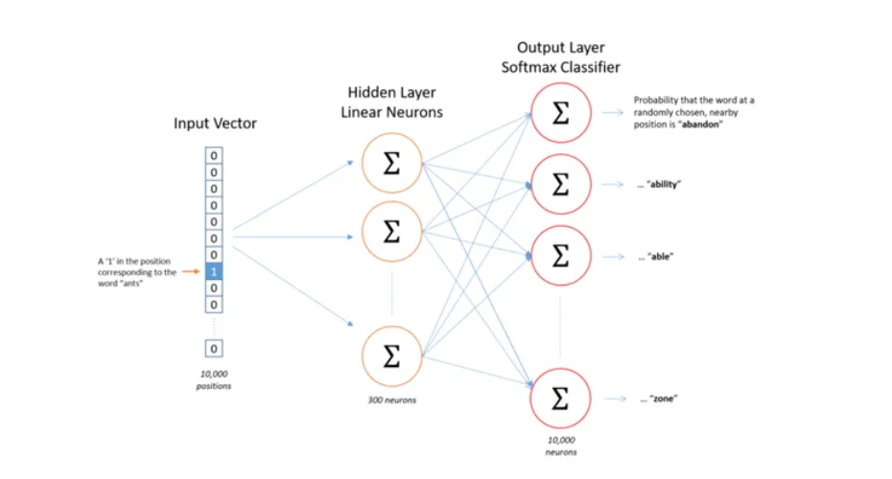
Word2Vec

Slide 6
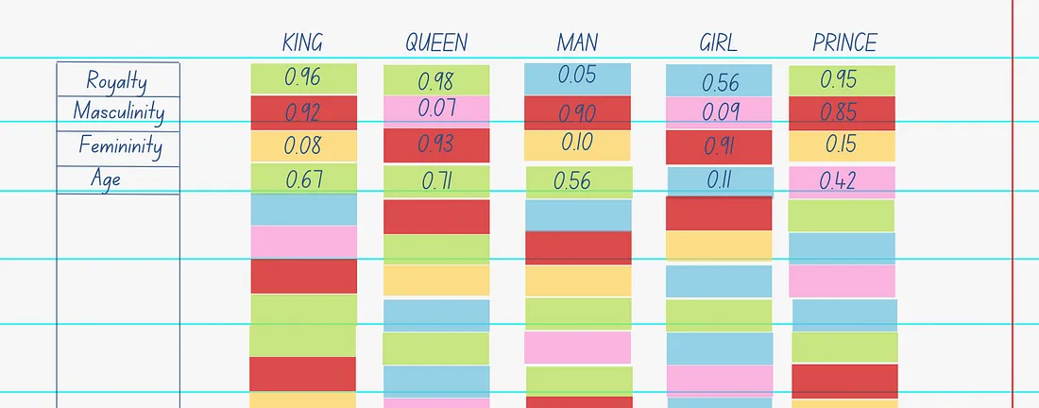
Word2Vec

Slide 7
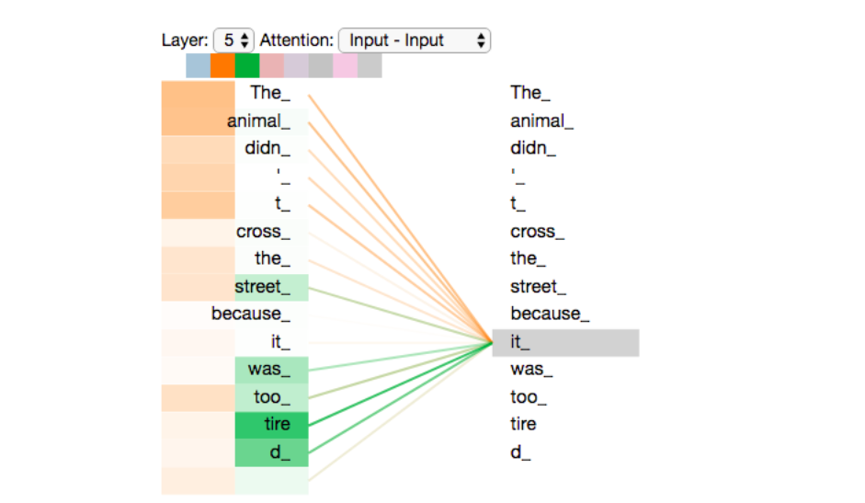
Attention

Slide 8
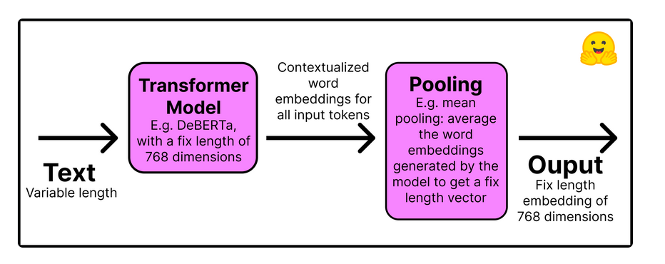
Sentence Transformers

Slide 9
Langchain Integrations
Huggingface
Cohere
Openai
Llamacpp

Slide 10
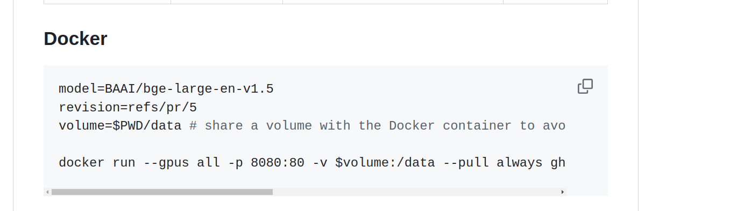
Text Embedding Inference

Slide 11
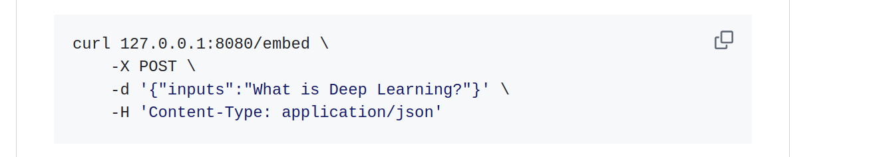
Inference

